Slide 1
RAMADDA
Repository for Archiving and MAnaging Diverse DAta
https://ramadda.org
Combines -
Content management system/Wiki
Scientific data repository
Visualization environment
Technology
Open source - https://github.com/geodesystems/ramadda
Java based
Runs stand-alone or in a servlet container (e.g., Tomcat)
Workshop site – https://ramadda.unidata.ucar.edu/repository/a/sipi_ntu

Slide 2
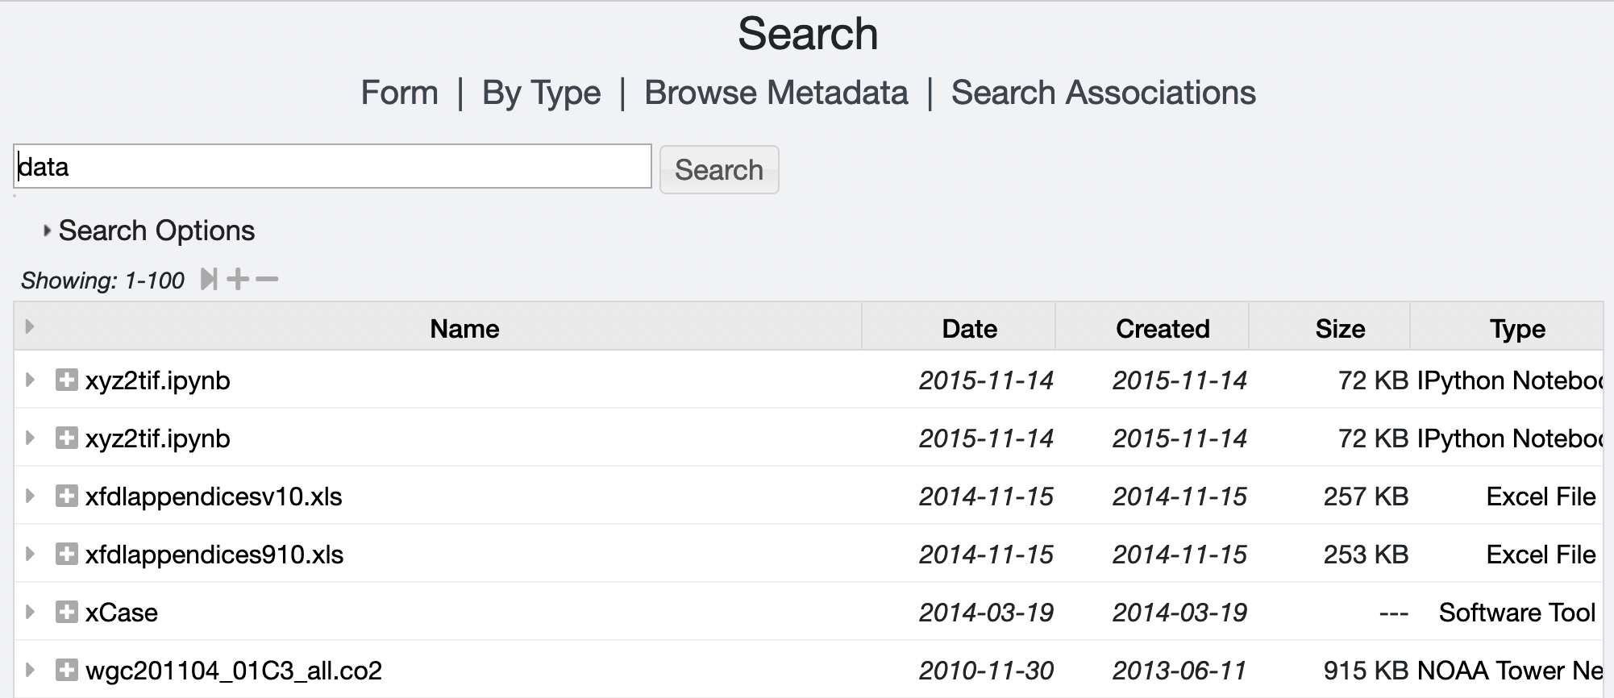
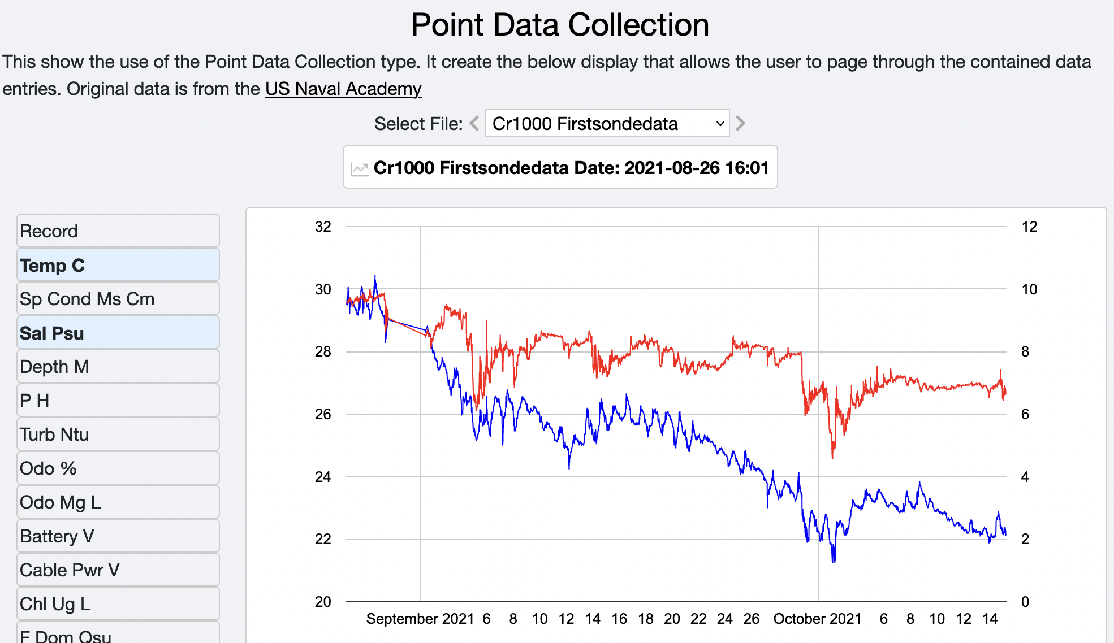
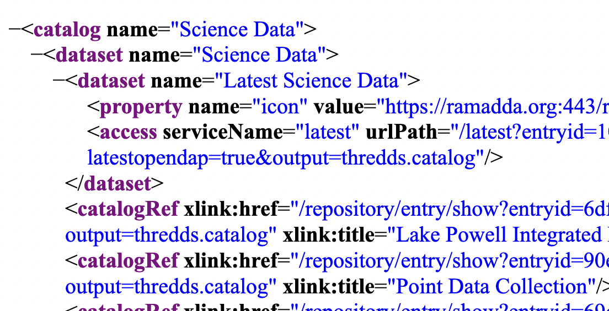
RAMADDA Model
Hierarchy of typed entries
Search
Folder
Tag
Wiki text &
displays
Keyword
Docs
Data
Wiki page
Image
Cr1000.csv
Services
Catalogs
Data, etc
Alias
Thumbnail
Properties attached to entries

Slide 3
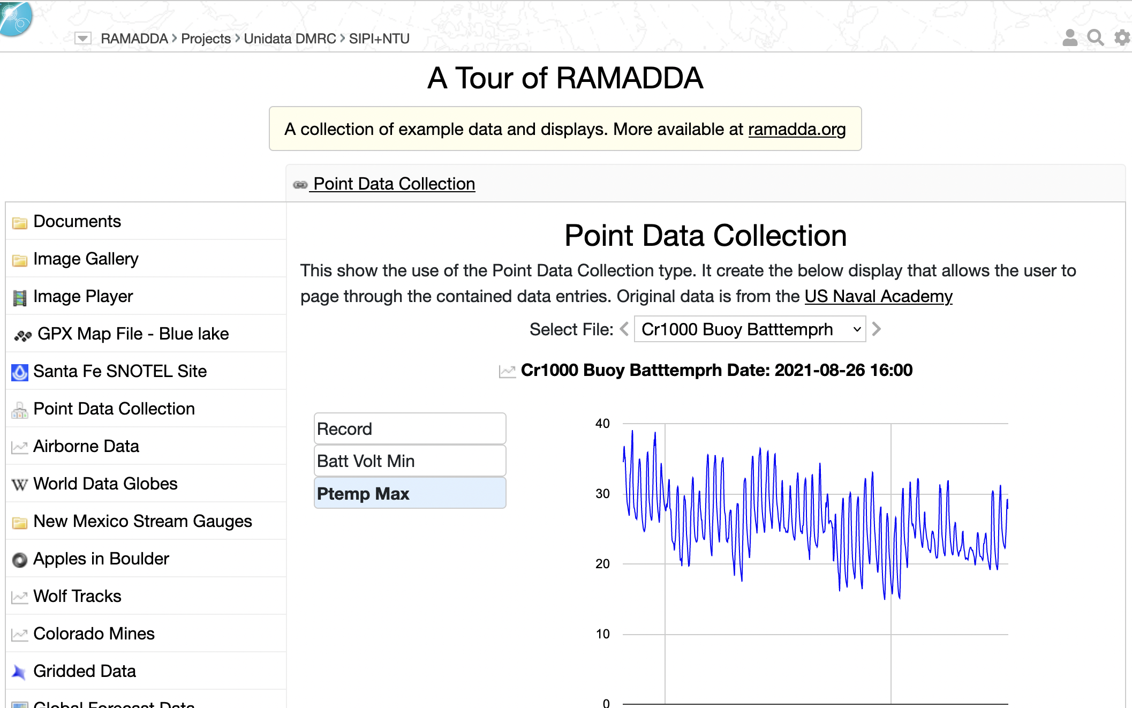
A Tour of RAMADDA
https://ramadda.unidata.ucar.edu/repository/a/ramadda_tour

Slide 4
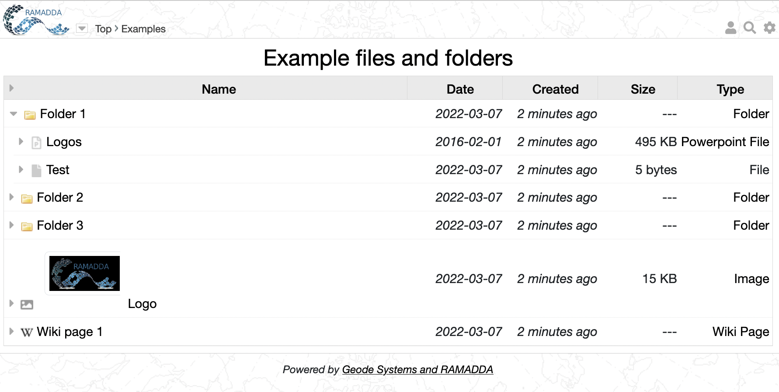
Entry Display
Login, search, settings, help
Breadcrumbs
You are always viewing an entry.
Here it is a folder called “Example files..”
Click on an arrow to open in place
Click on a link to go to that entry
There are folders, files
and other types of entries

Slide 5
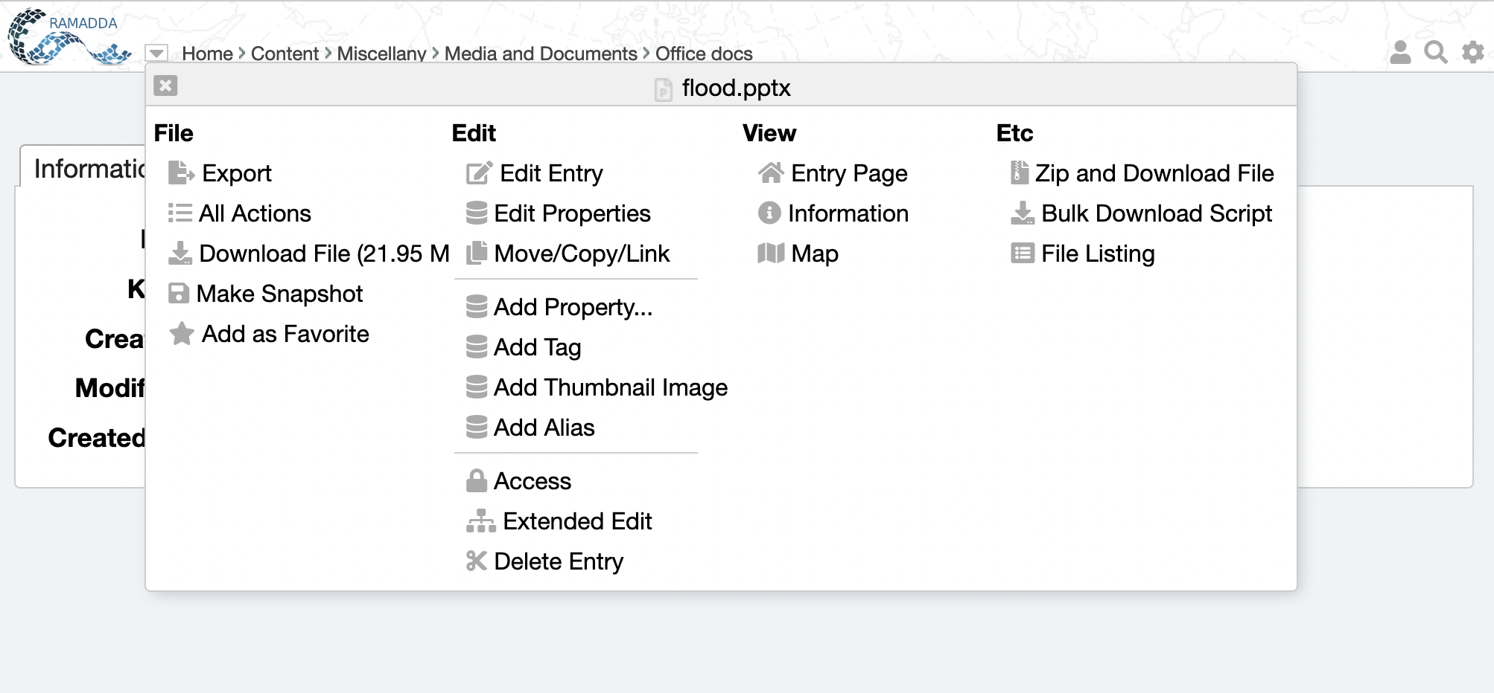
Entry Popup Menu
Popup menu
Information
All actions

Slide 6
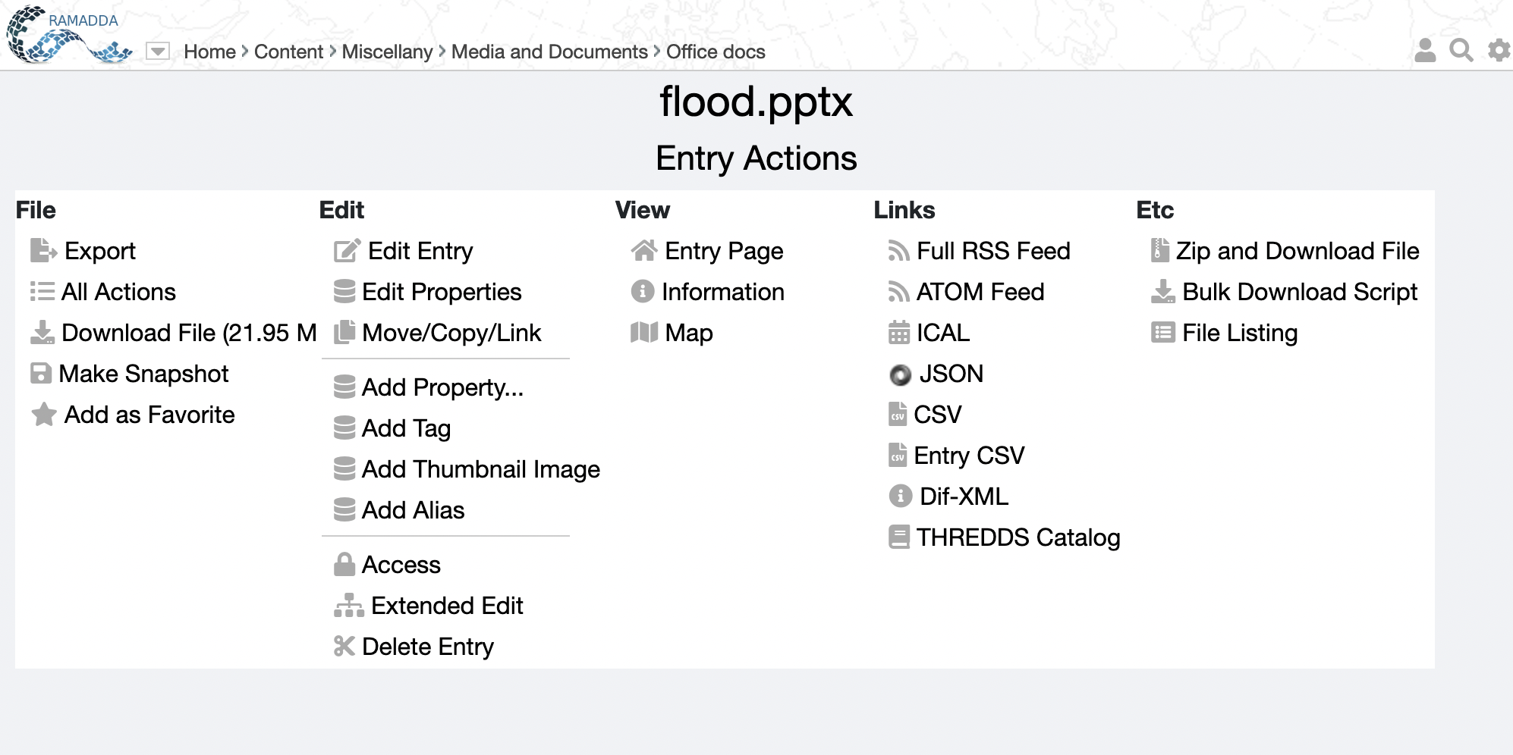
All Actions
All Action
Many ways to view and access an entry

Slide 7
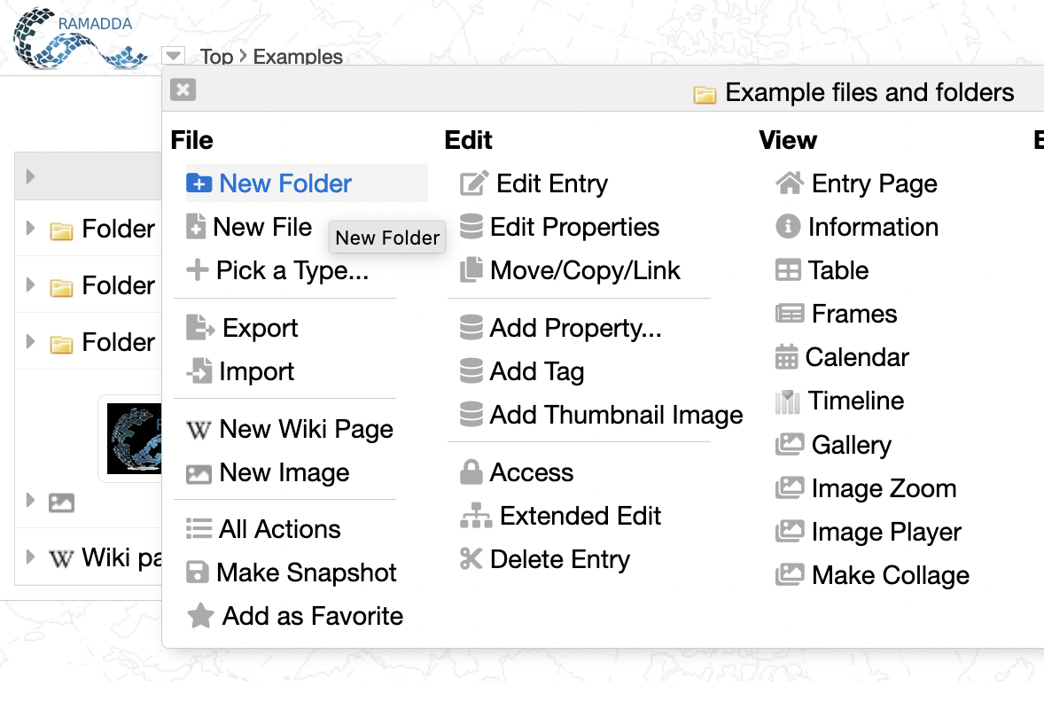
New Folder
Now we’re going to create some content. Login and go to your home entry. Click on the entry popup menu and select “New Folder”

Slide 8
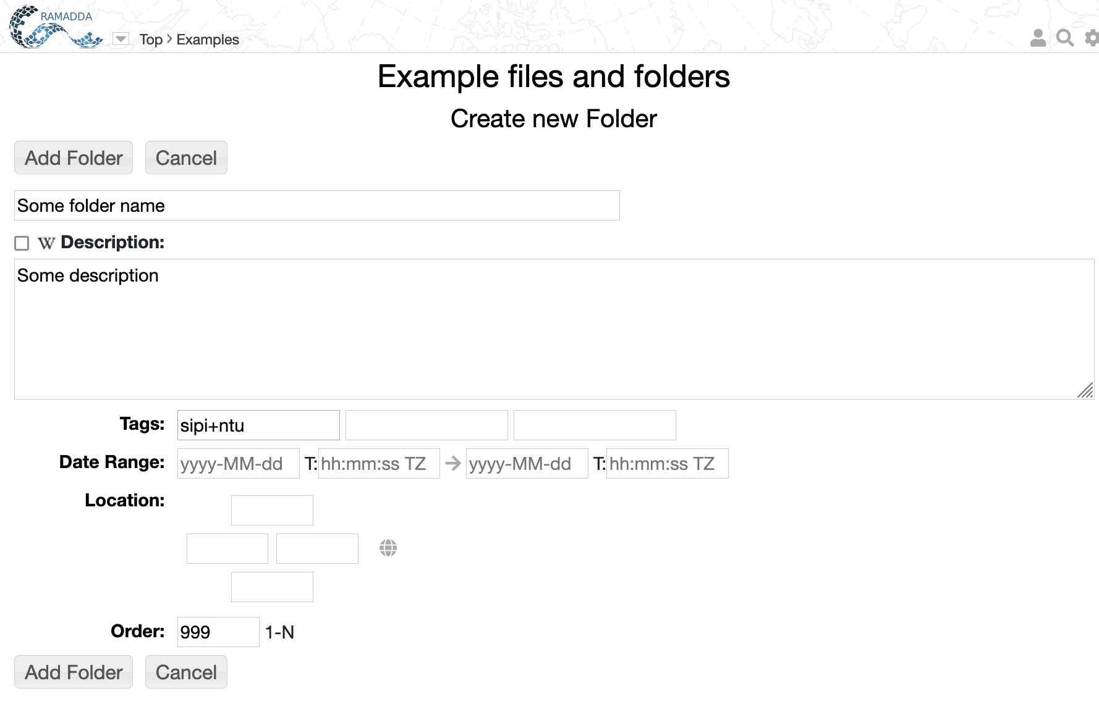
New Folder
Enter a name and some description
You can add multiple tags

Slide 9
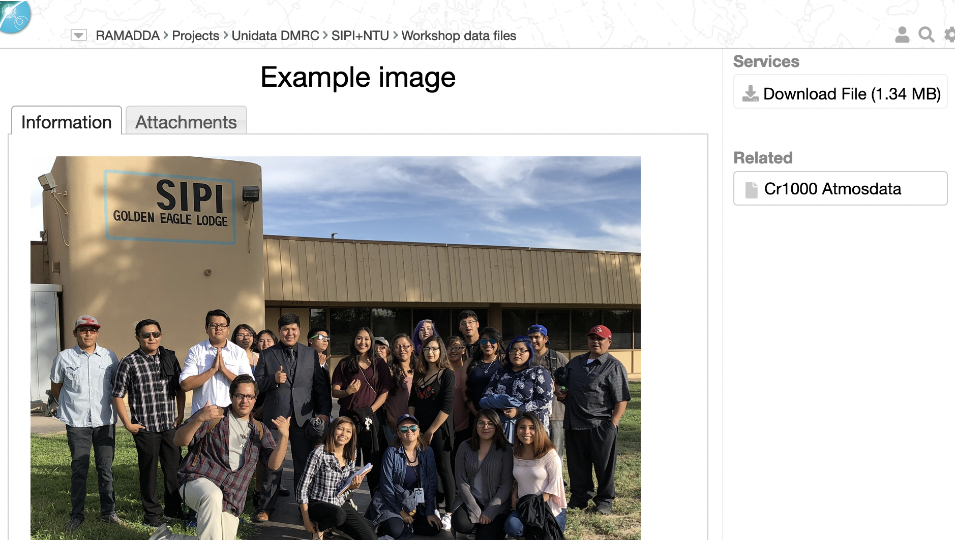
New Files
Now we’re going to upload some files
First – go to the Workshop Data Files ->Example image
https://ramadda.unidata.ucar.edu/repository/a/workshop_files
Download the image file and save it to disk

Slide 10
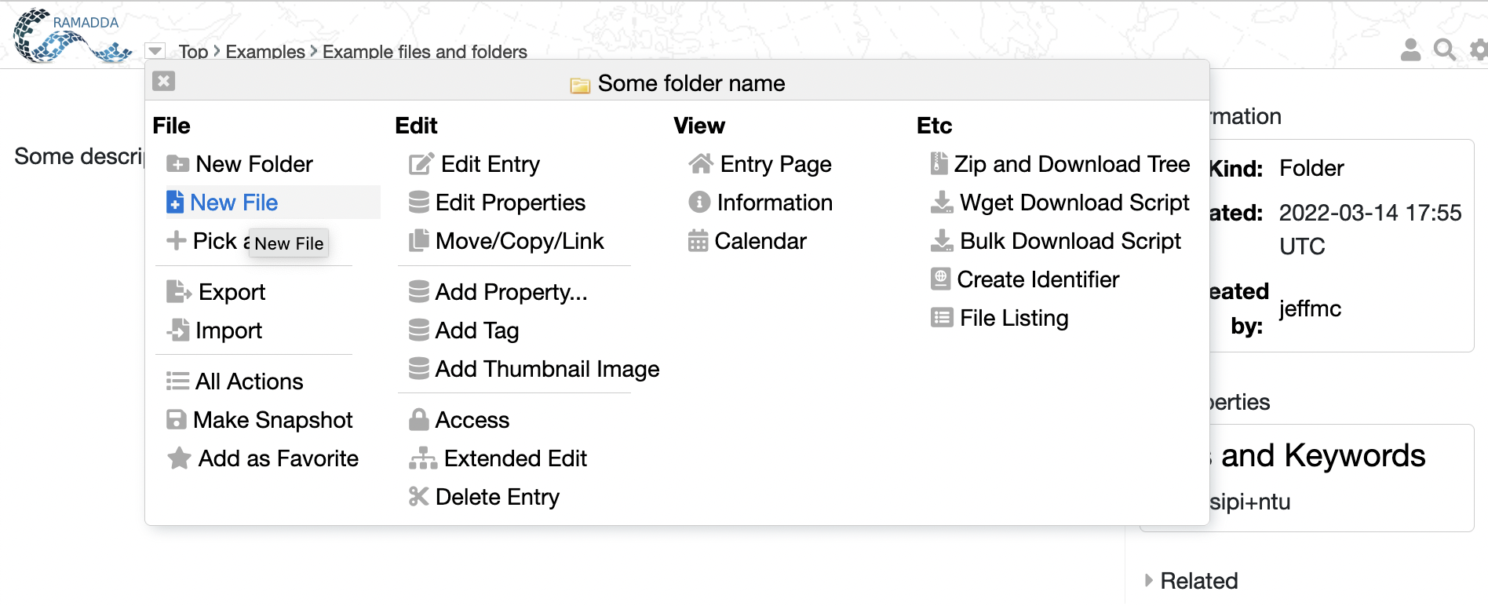
New Files
Now, go back to the new folder entry you just created and click on the entry popup menu and choose New File
Choose New File

Slide 11
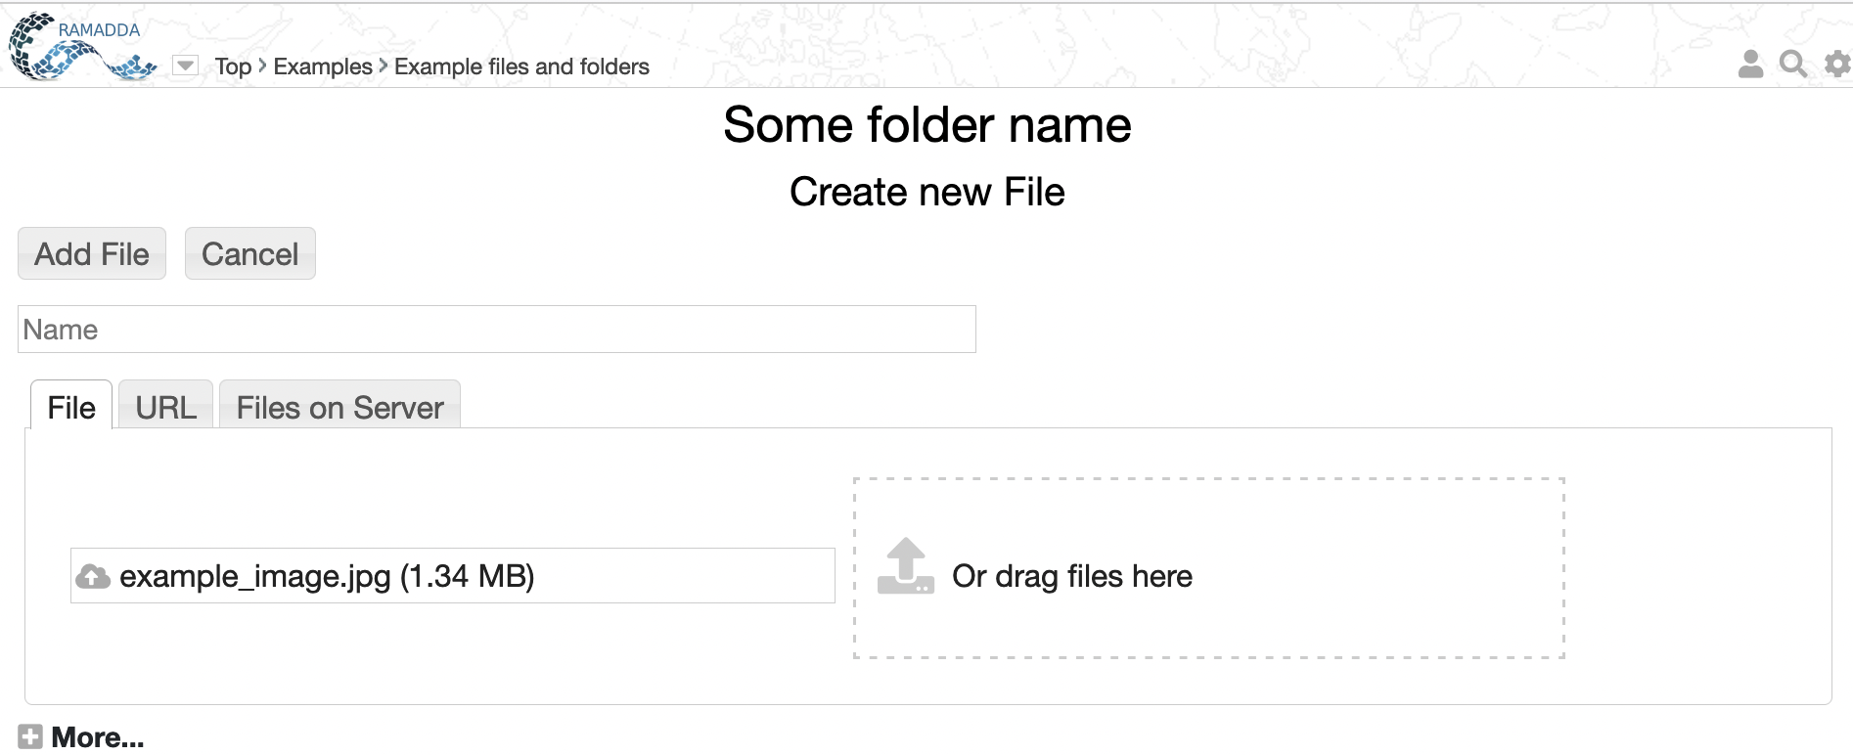
New Files
Select the example image file and press Add File

Slide 12
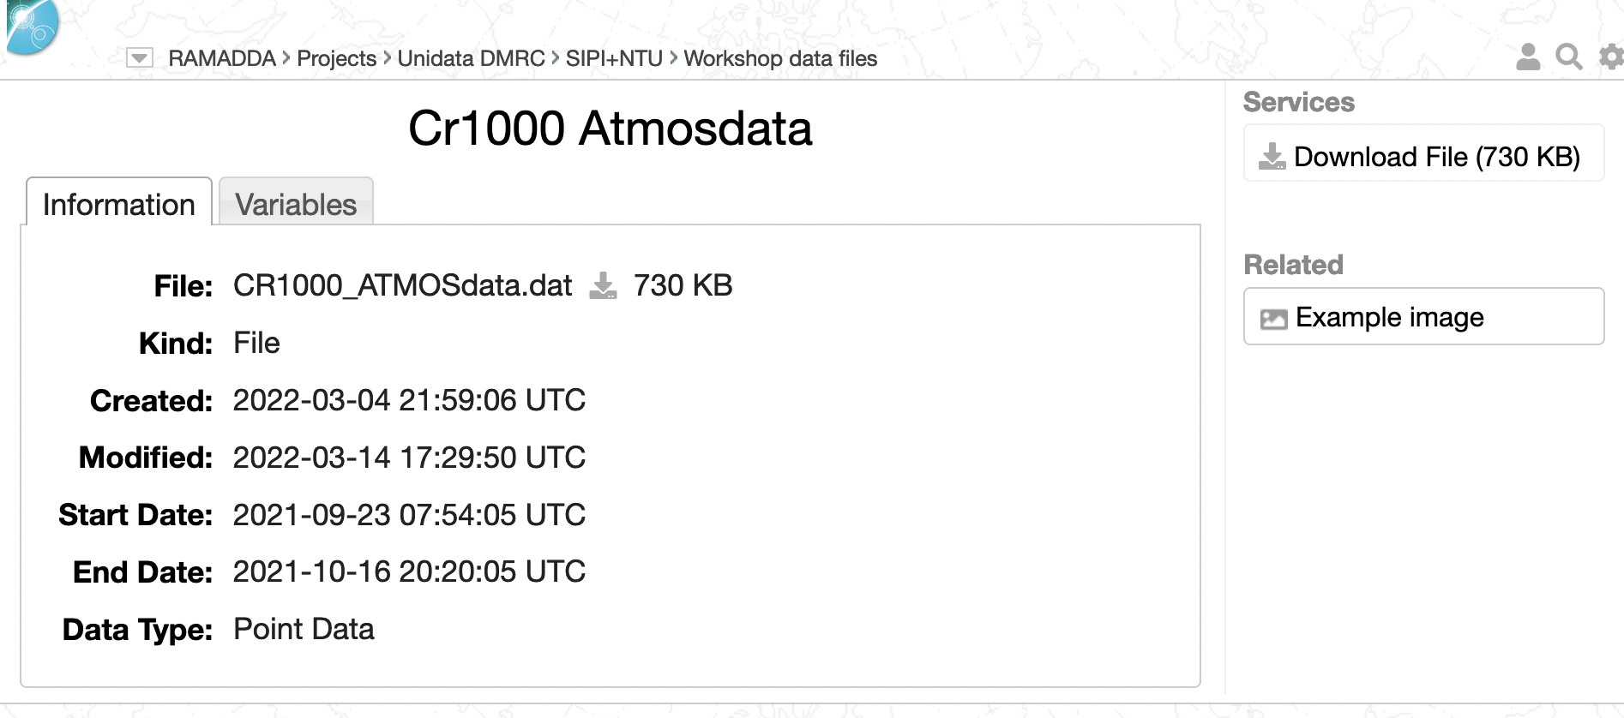
New Files – Specifying the Type
Now we’re going to upload a data file
First – go to the Workshop Data Files ->Cr1000 Atmosdata entry
and download the data file and save it to disk

Slide 13
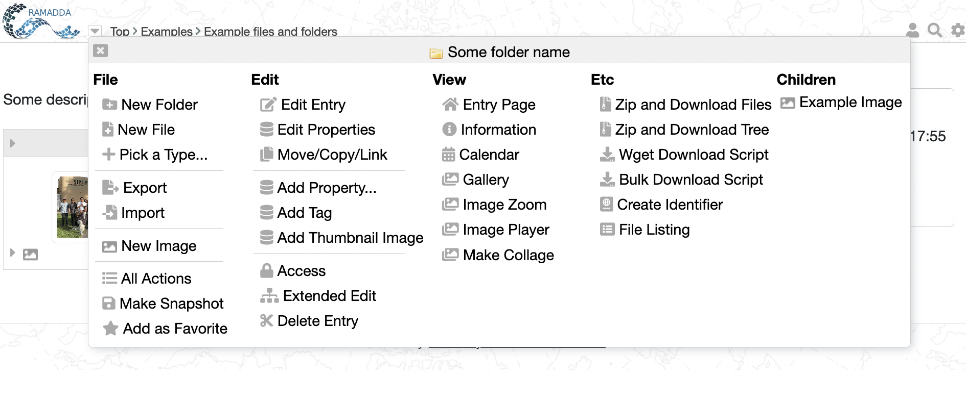
New Files – Specifying the Type
Now go back to your new folder and this time select “Pick a Type…”
Pick a type

Slide 14
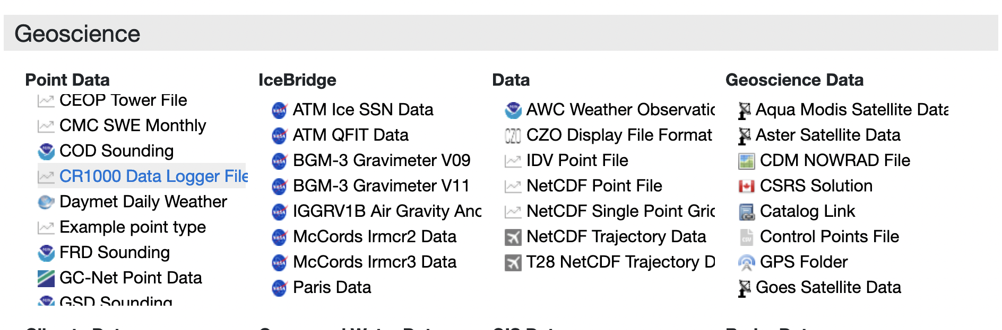
New Files – Specifying the Type
As you can see RAMADDA supports many different entry types.
Under Geoscience->Point Data select CR1000 Data Logger File

Slide 15
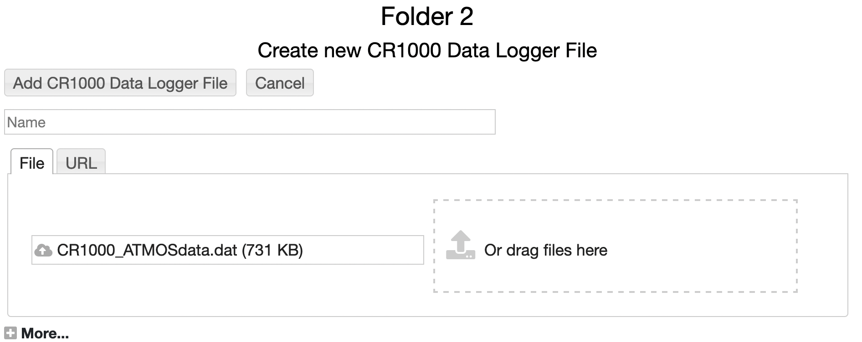
New Files – Specifying the Type
Select the data file you just downloaded and press “Add CR1000 Data Logger File”

Slide 16
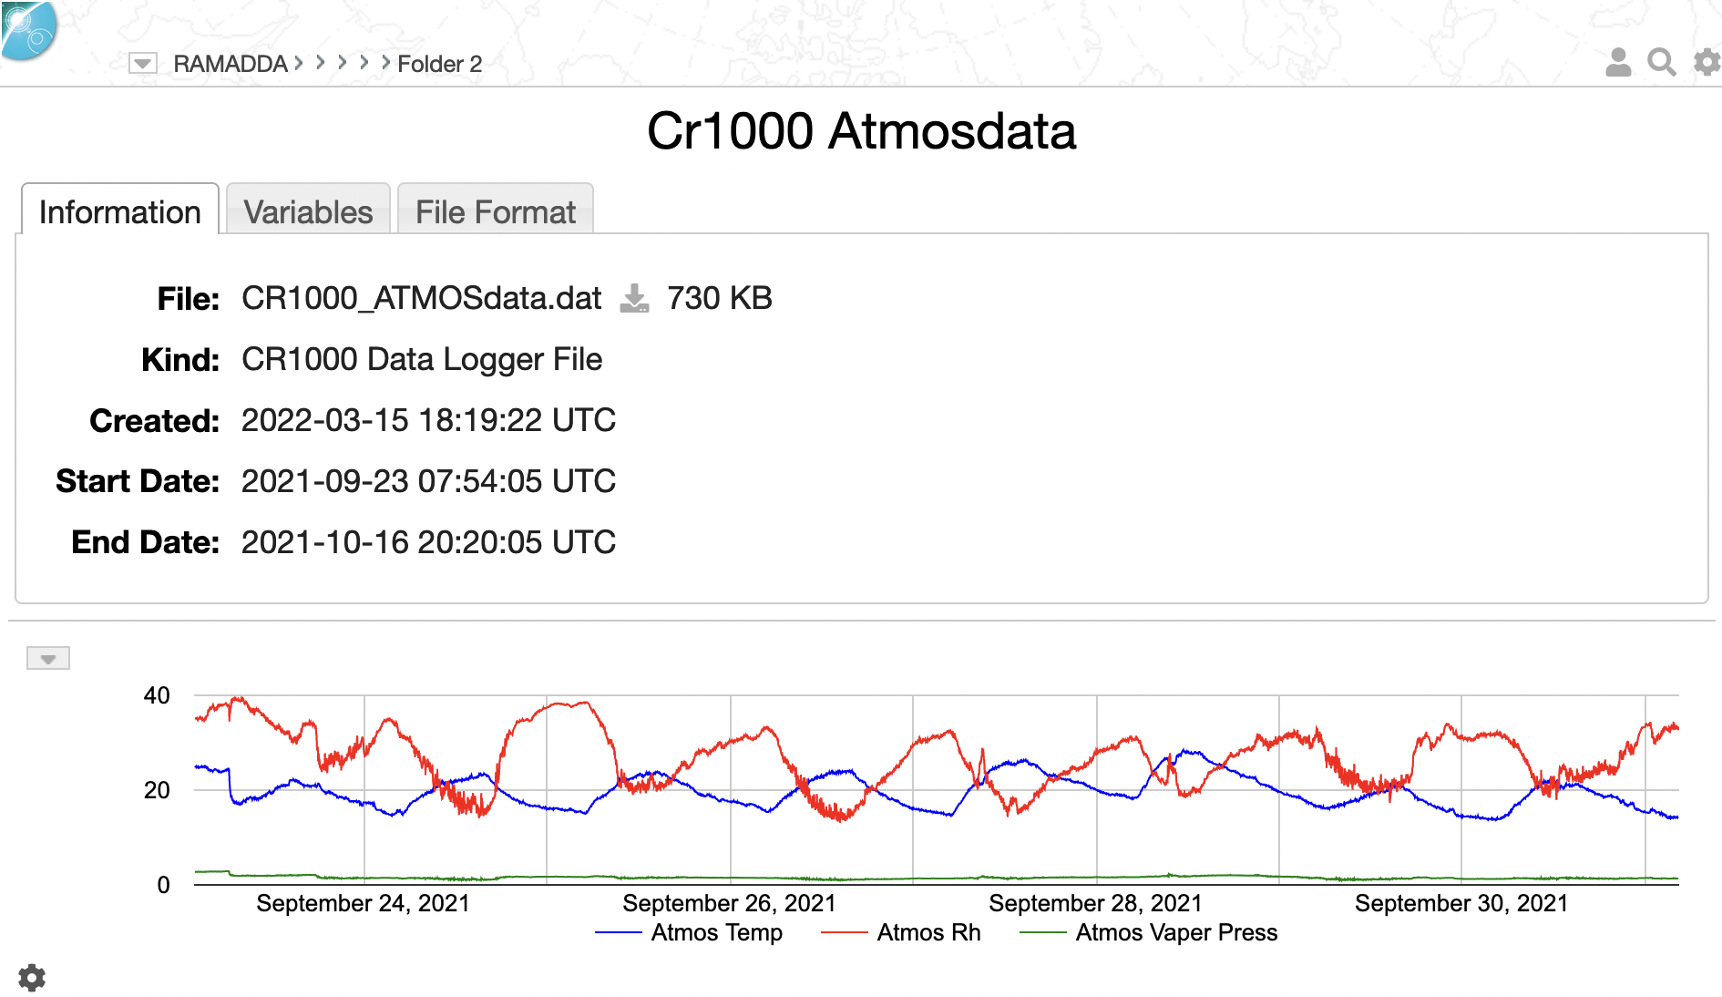
New Files – Specifying the Type
RAMADDA will process the file, extracting temporal and other metadata.
The default view of the CR1000 Data Logger entries is the metadata information and an interactive line chart

Slide 17
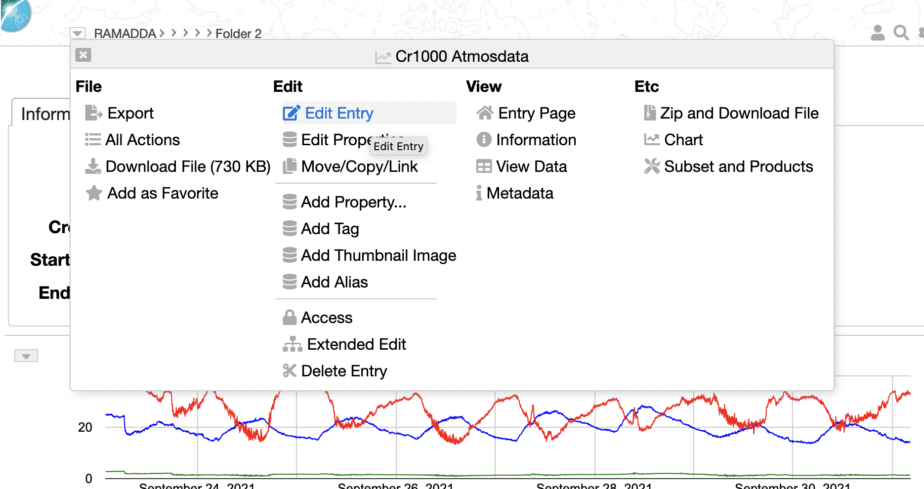
Editing, Deleting, etc
Through the entry popup menu you can select Edit Entry, Edit Properties, Add Property, Delete Entry, etc
Export – returns a zip file with entry information and any files. Go ahead and export this entry. Go to the parent folder and do an Import

Slide 18
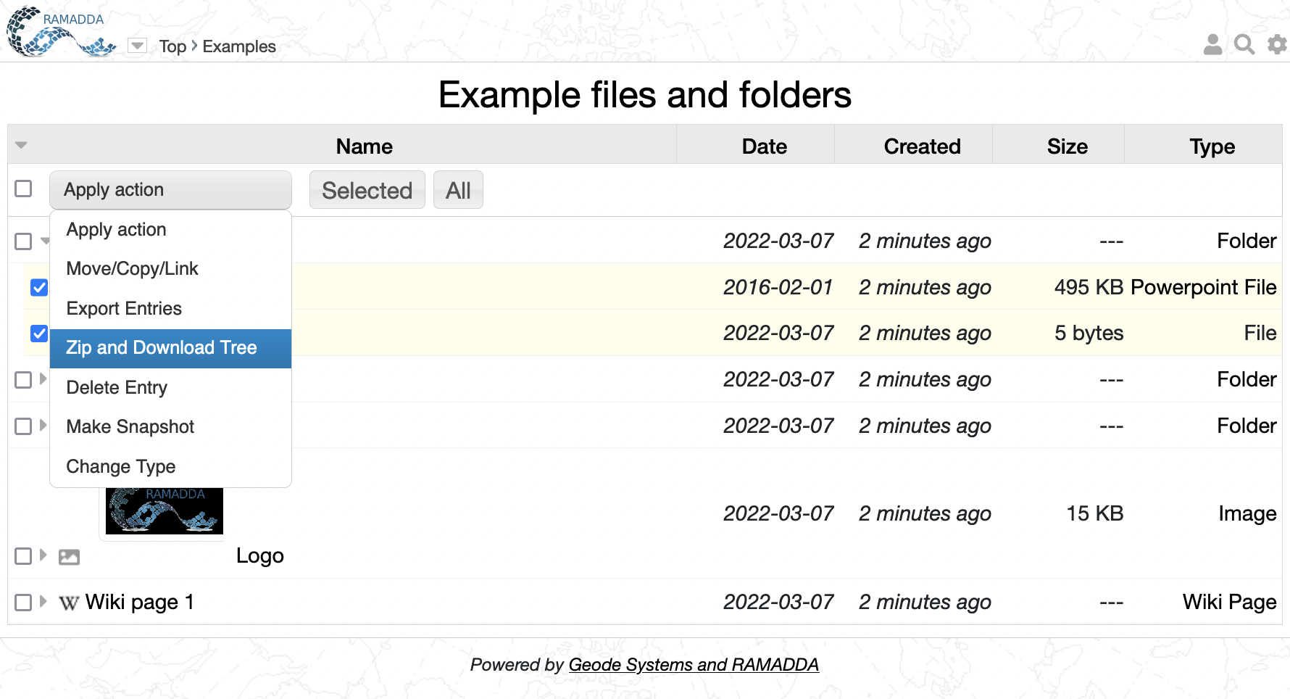
Managing multiple entries
Now we’re going to look at how to manage multiple entries
Toggle form
Select action
Do it
Select entries

Slide 19
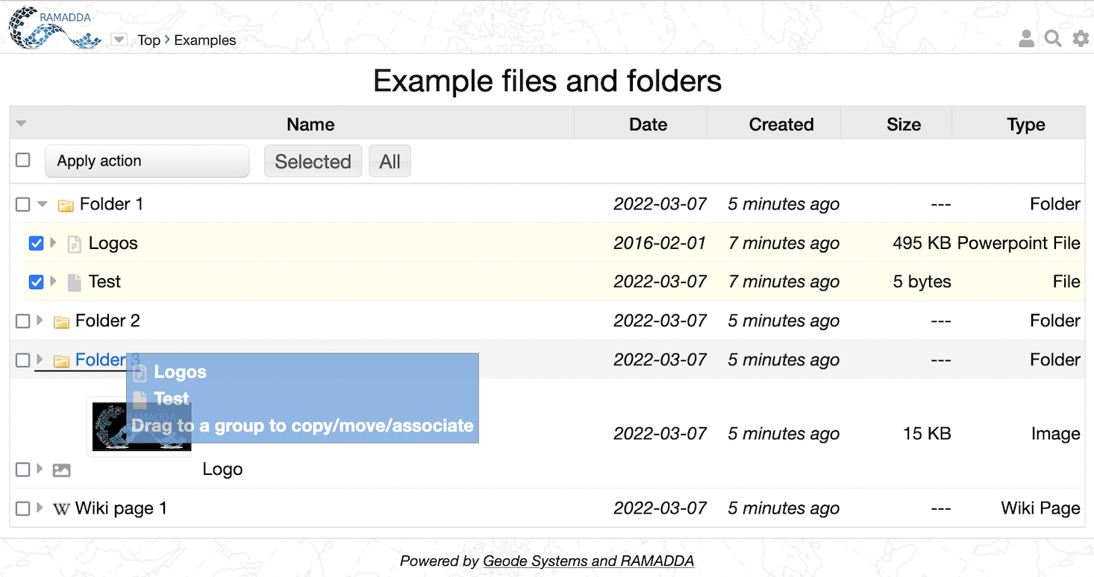
Drag-and-Drop
Click and drag on an icon
Drop it on the destination entry

Slide 20
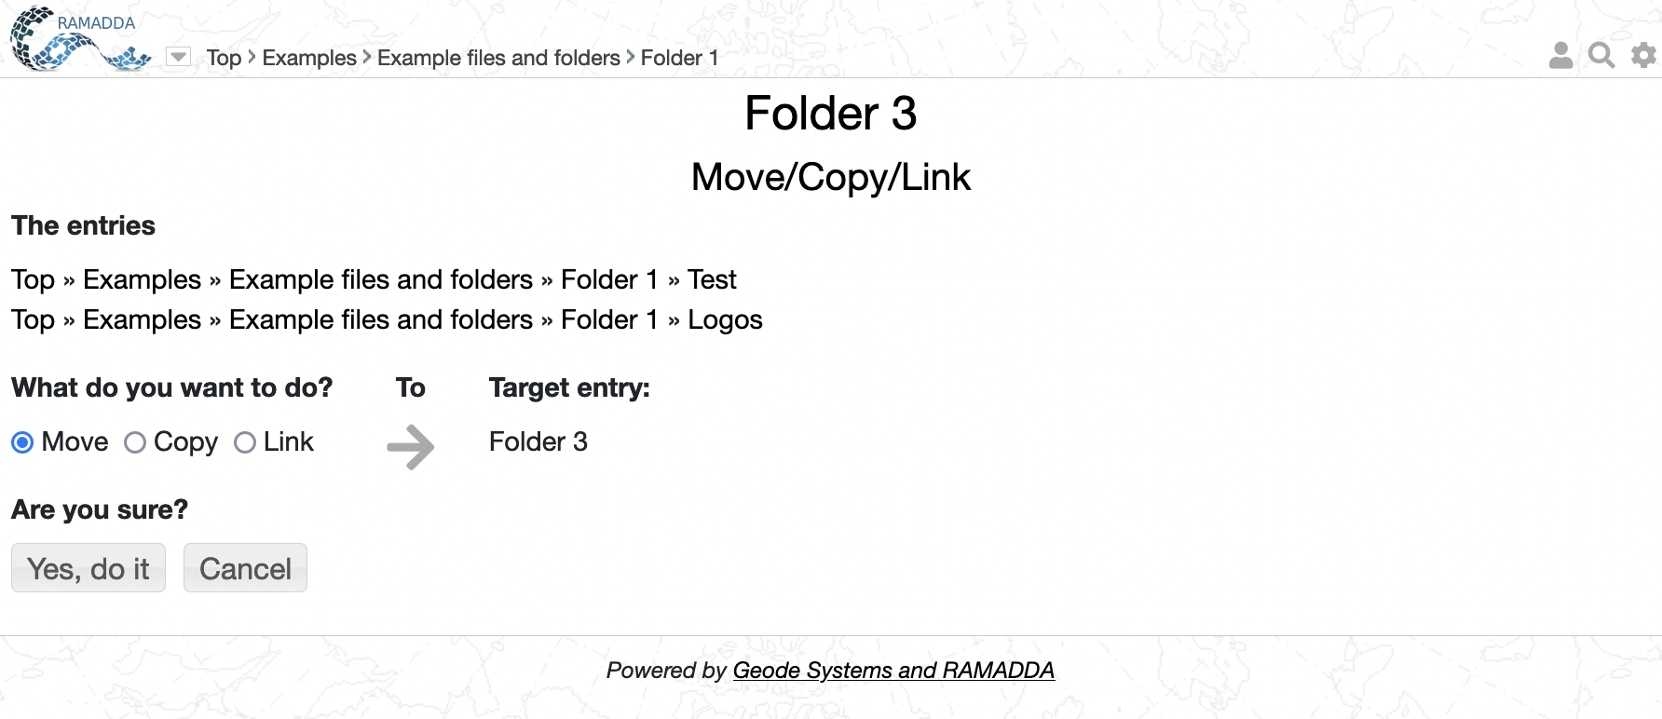
Move/Copy Confirm
Select action

Slide 21
Entry Access
RAMADDA has a hierarchical action/role access control
Users, IP address and user roles are granted or denied rights to perform actions
Actions are-
View – can the entry be accessed at all
Edit/New/Delete – can users edit entries, create new entries, etc
File – Can the file associated with the entry be downloaded
Export – Can the entry be exported
Anonymous upload – Can anonymous users upload files (will be quarantined until an admin makes the file public
Let’s see this in action

Slide 22
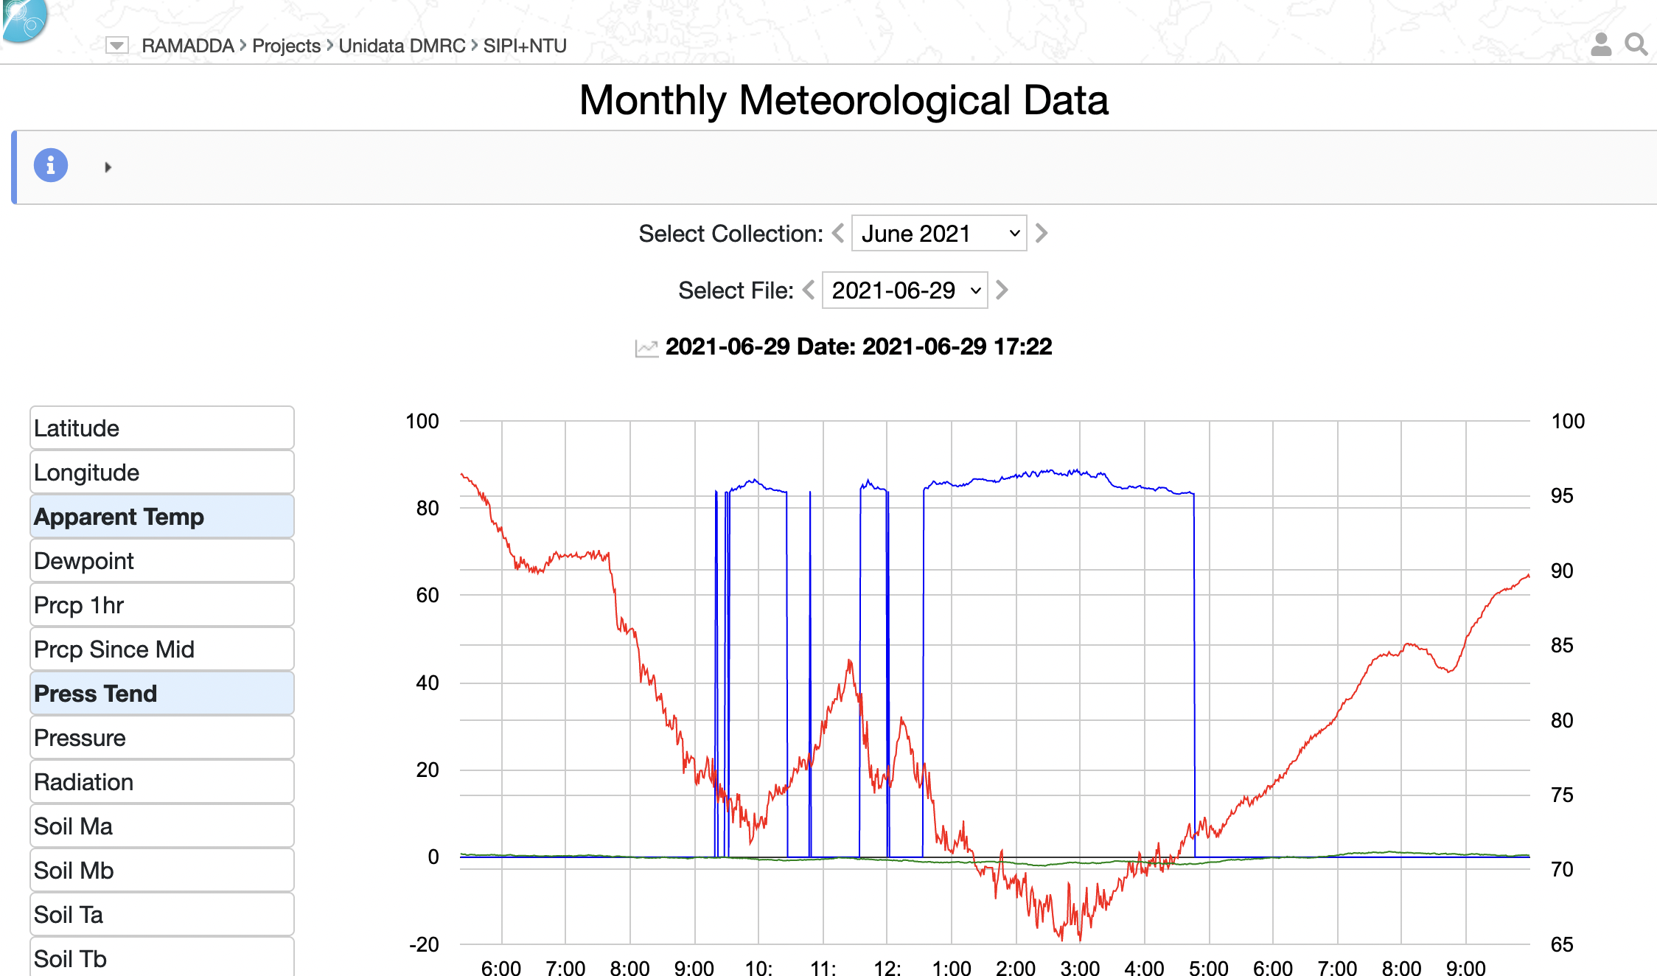
Point Data Collection of Collections
Let’s look at the Monthly Meteorological Data
This is a specialized entry that contains any number of children Point Data Collection entries – a collection of collections.
Select the month
Page through the files

Slide 23
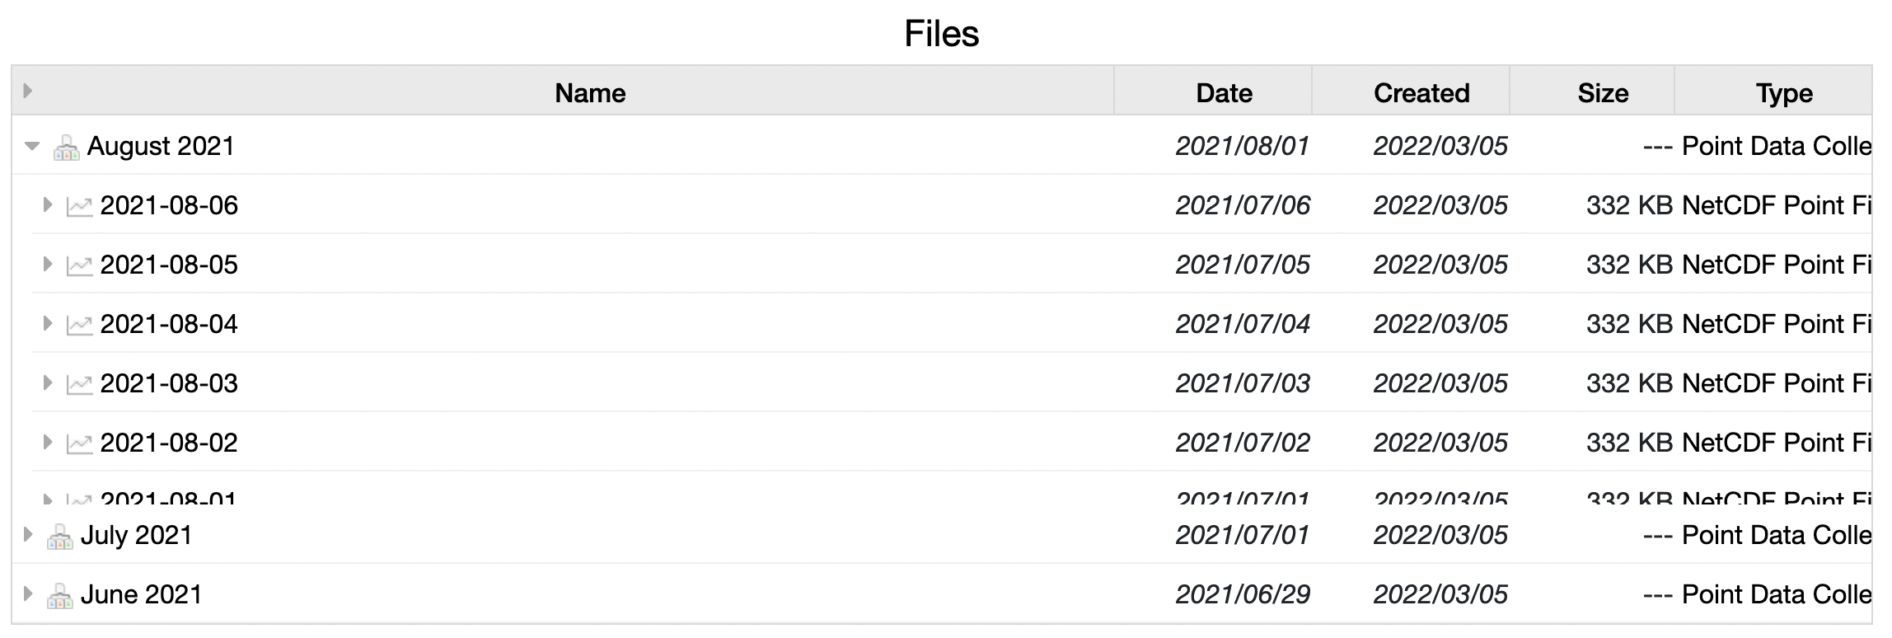
Point Data Collection
Scrolling down we can see the tree of entries.
The children entries are each of type Point Data Collection
The data files are NetCDF Point files
Let’s look at August 2021
Select action

Slide 24
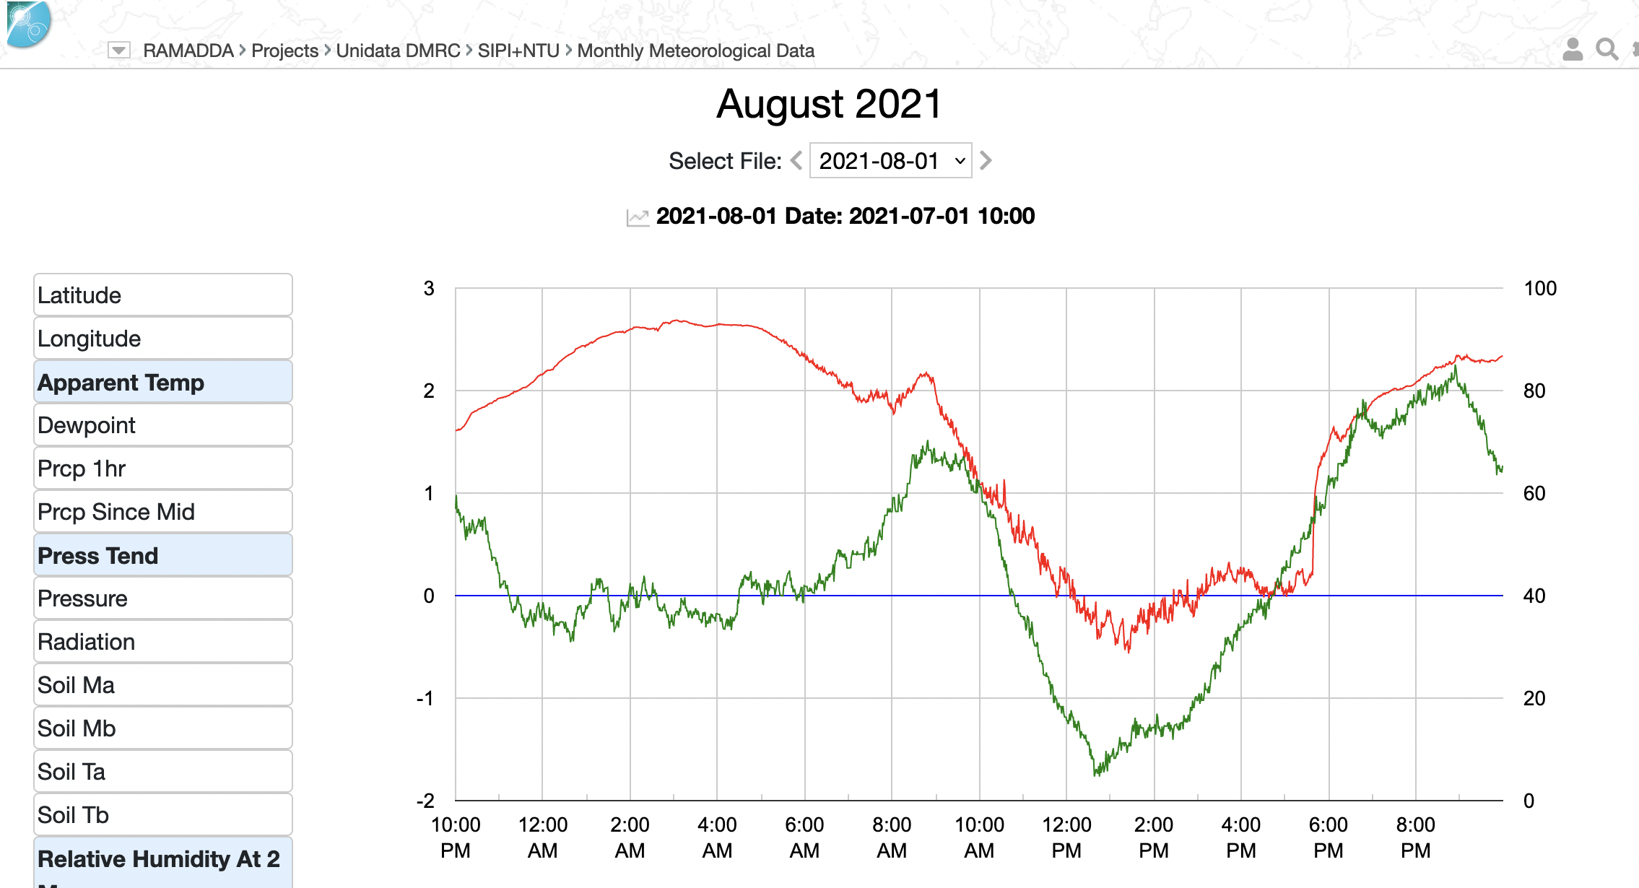
Point Data Collection

Slide 25
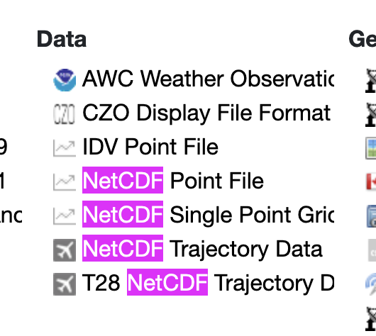
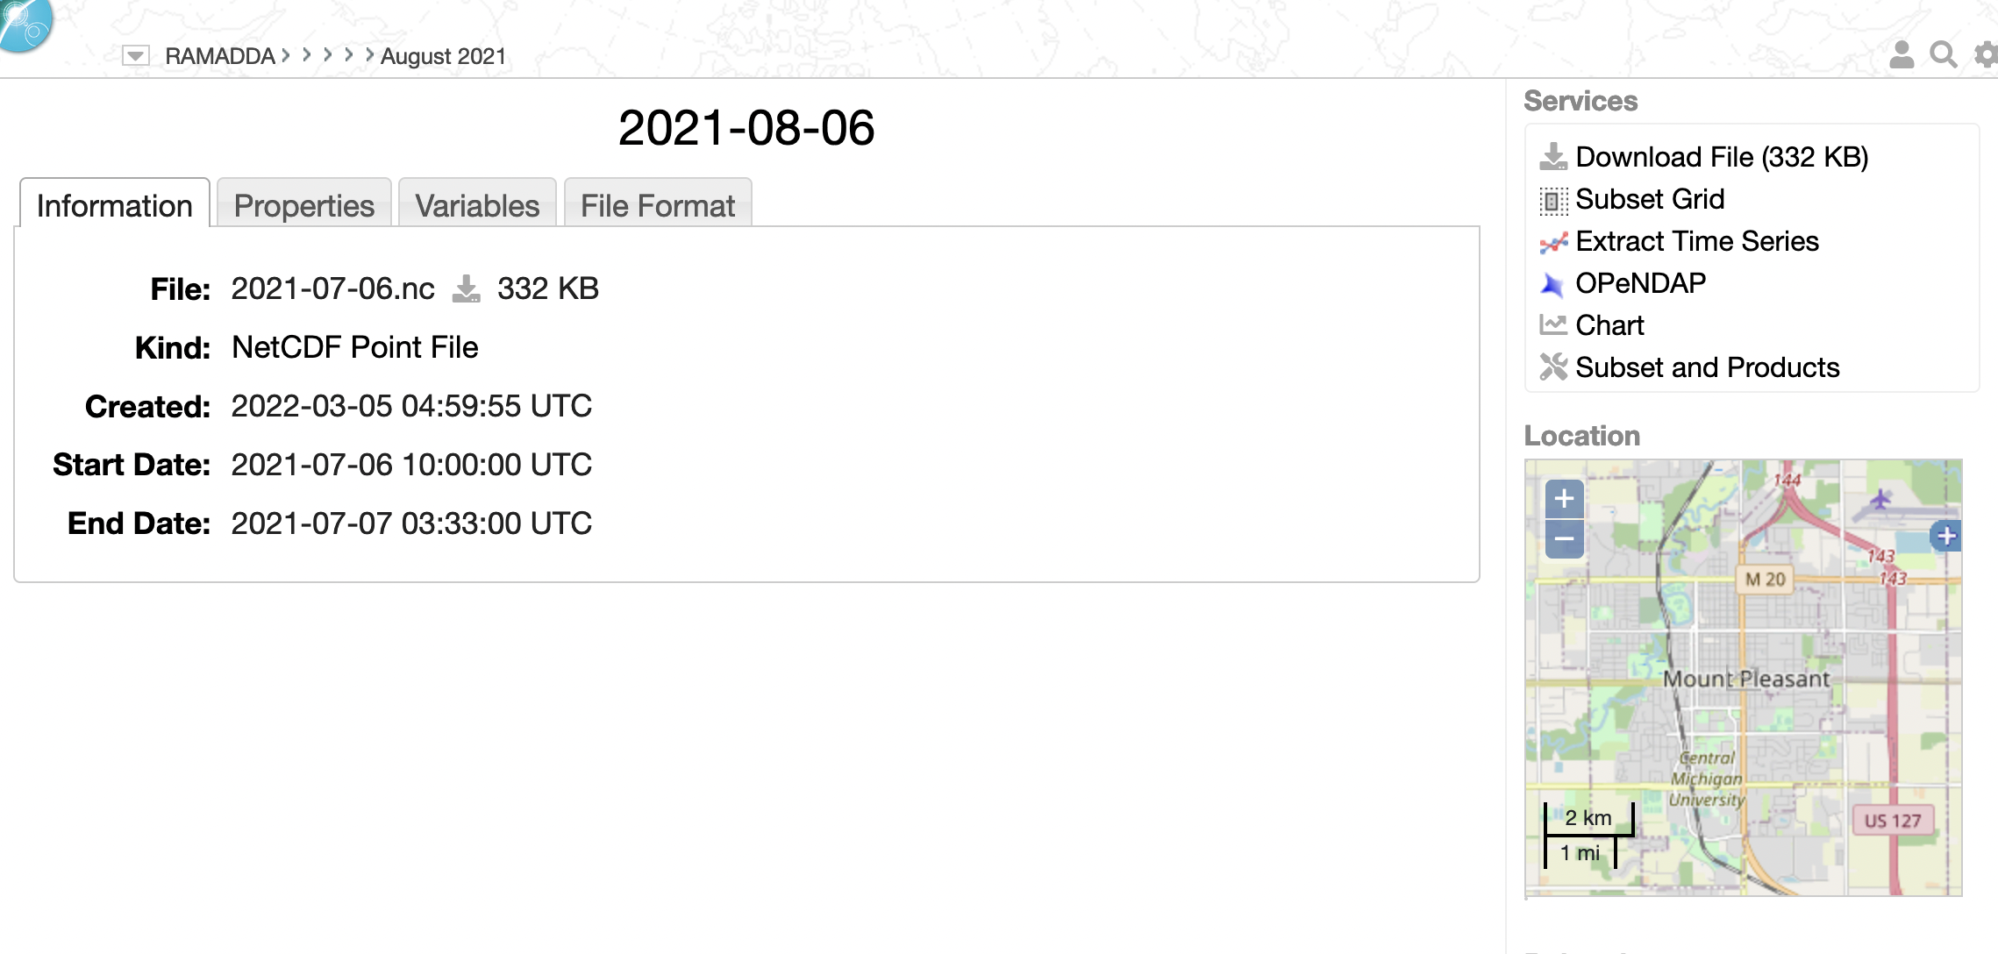
NetCDF Point File
Download the file
Go to your local home directory and choose Pick a Type…
Choose “NetCDF Point File”
Temporal, spatial and faceted metadata automatically extracted

Slide 26
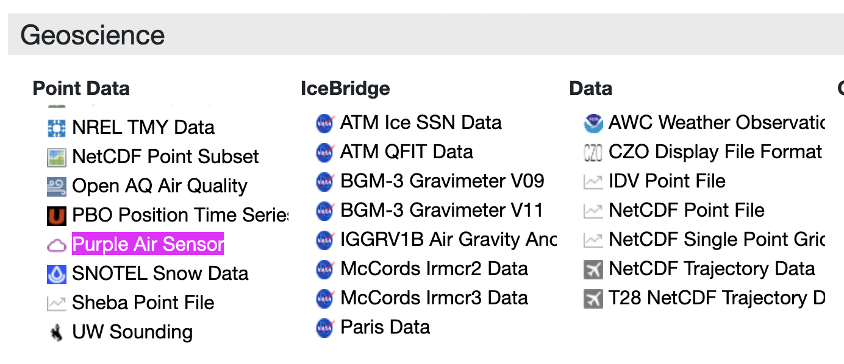
Create Purple Air Sensors
Create a folder, e.g. “Purple Air”
Select “Pick a type…” from the entry menu
Select Purple Air Sensor

Slide 27
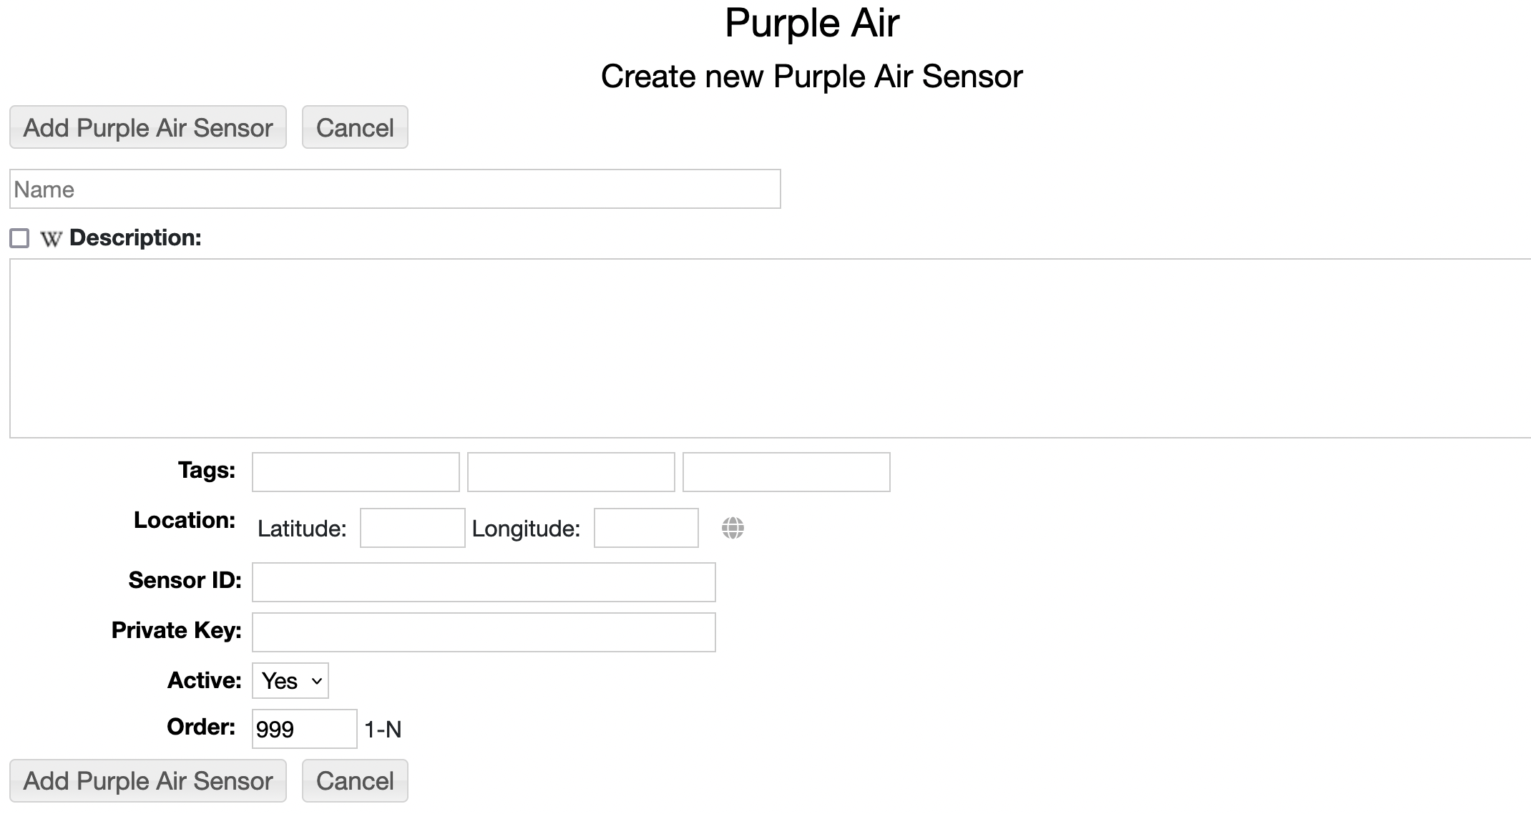
Create Purple Air Sensors
All you need to specify is a Sensor ID
In another window go to the Purple Air site - https://map.purpleair.com
Sensor Key

Slide 28
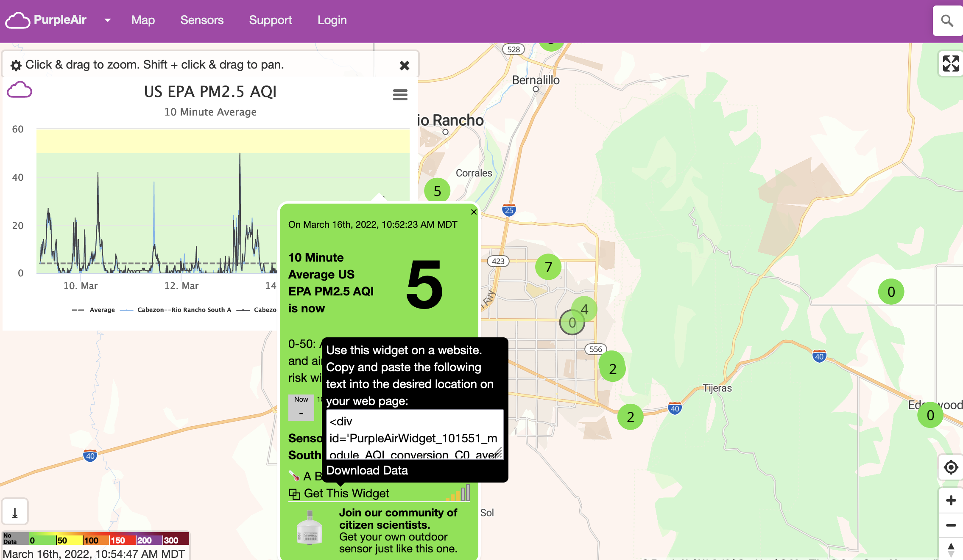
Create Purple Air Sensors
Select a site
Mouse over “Get this widget”
The site id, e.g., is 101551
Remember that number
Sensor Key

Slide 29
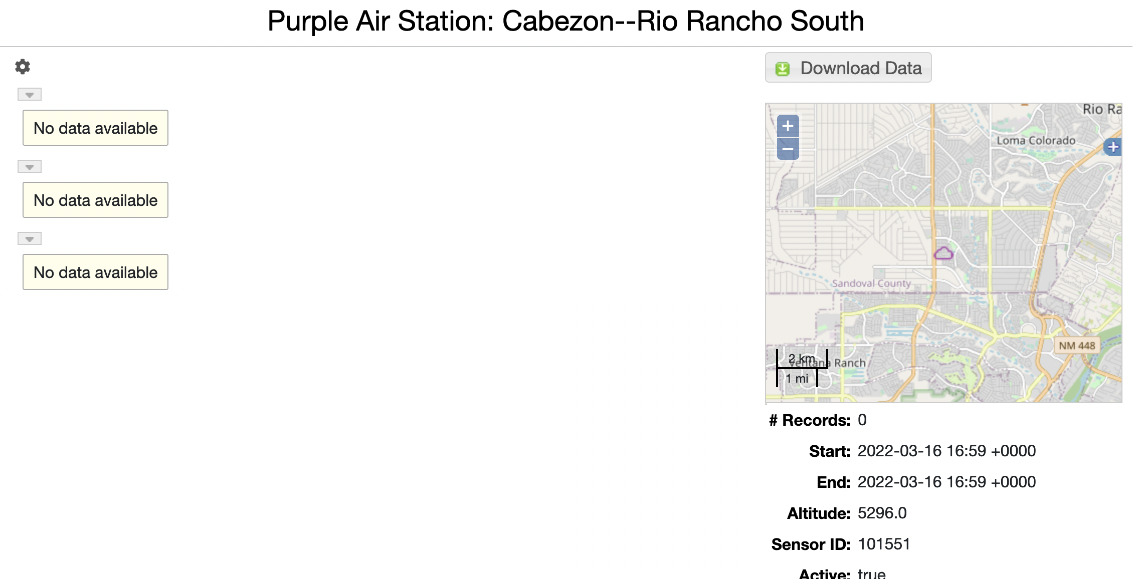
Create Purple Air Sensors
RAMADDA fetches site metadata from Purple Air
Note: New data is fetched from Purple Air periodically so initially no data is available
Sensor Key

Slide 30
Title
Select action

Slide 31
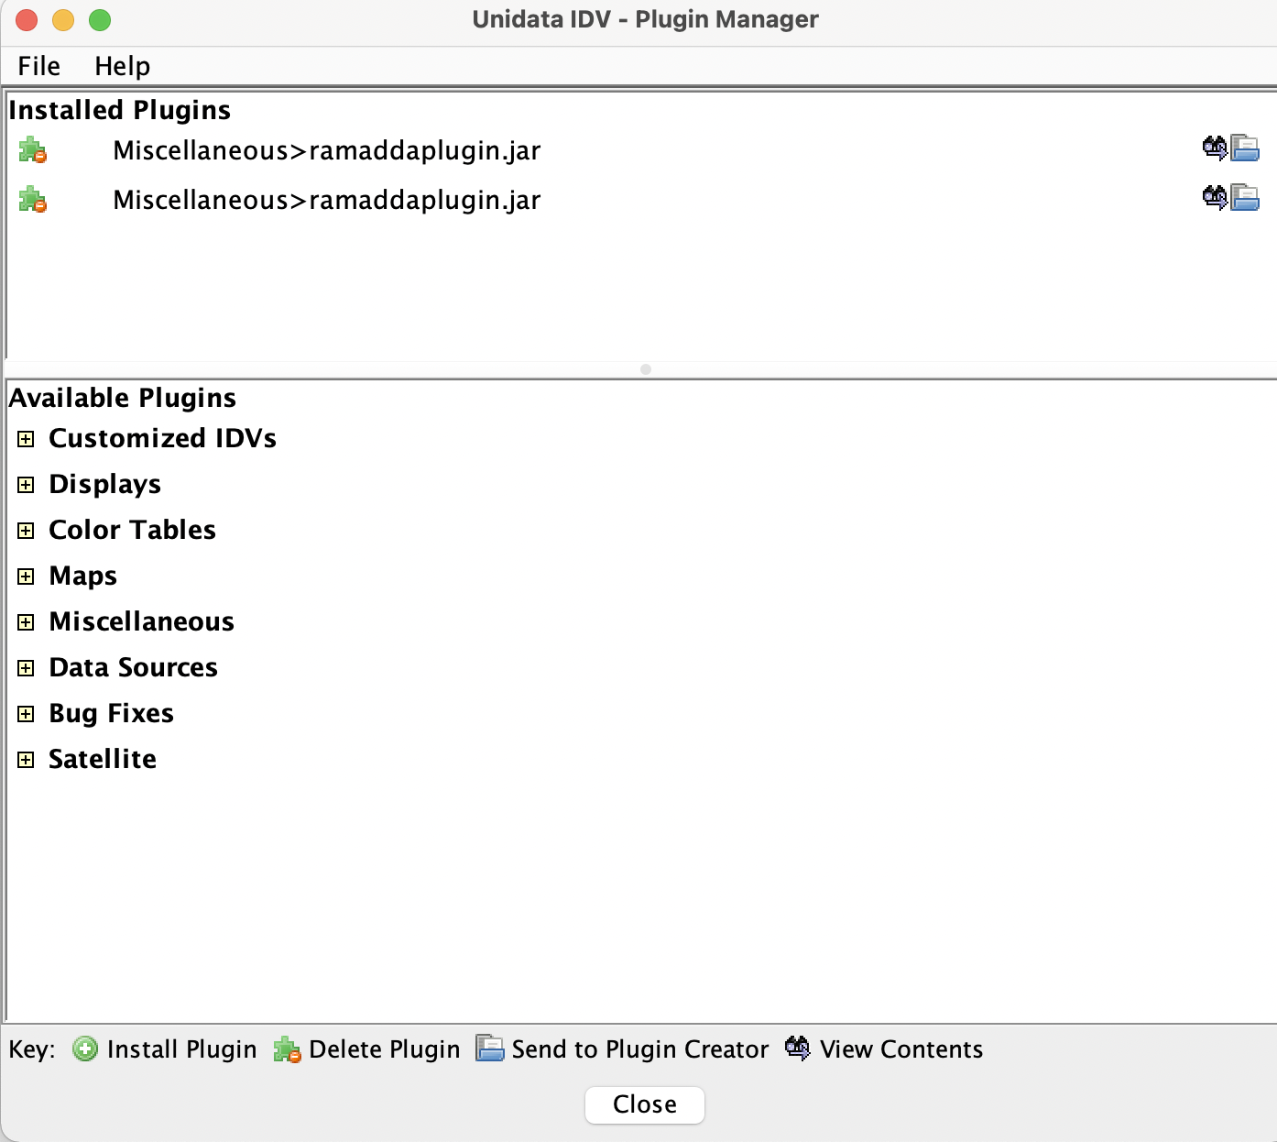
IDV/RAMADDA Integration
The IDV can publish images, movies, data and bundles to RAMADDA
First, install the RAMADDA publisher plugin to your IDV
Under the Workshop data files download and save the Ramaddapplugin.jar file
In the IDV go to Tools->Plugin Manager
Go to File->Install plugin from file
Select ramaddaplugin.jar
Restart the IDV

Slide 32
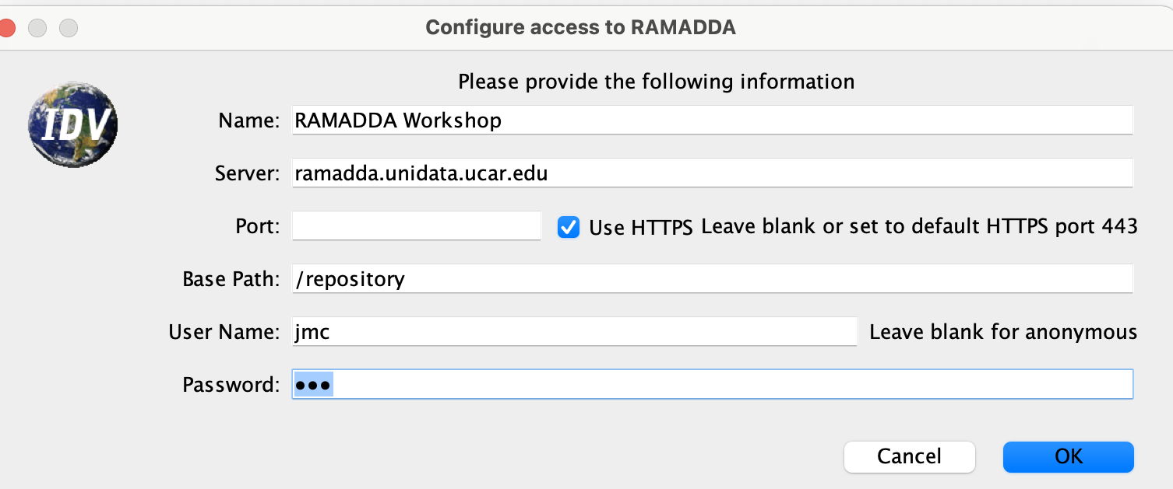
IDV/RAMADDA Integration
Next, create a new publisher in the IDV
Go to the main File->Publish->New->RAMADDA Publisher menu
Enter the below information
Clear the port and click on Use HTTPS …
Enter your RAMADDA user name and password and press OK

Slide 33
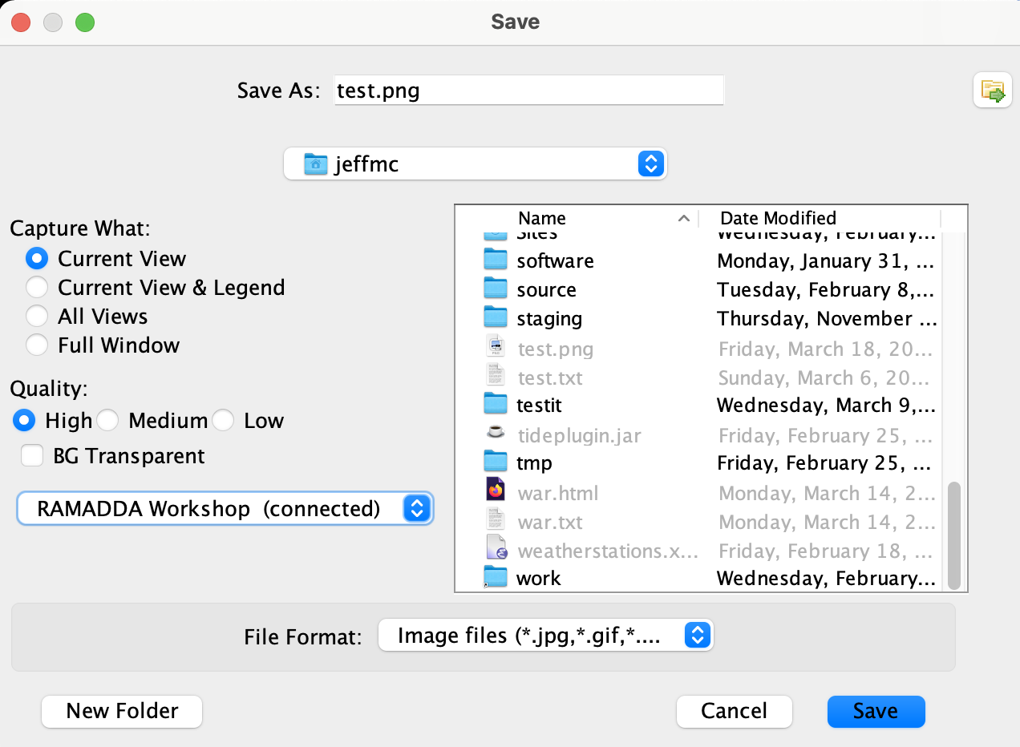
IDV/RAMADDA Integration
Now, back to the main IDV page.
Under the View menu select Capture->Image…
Select RAMADDA Workshop

Slide 34
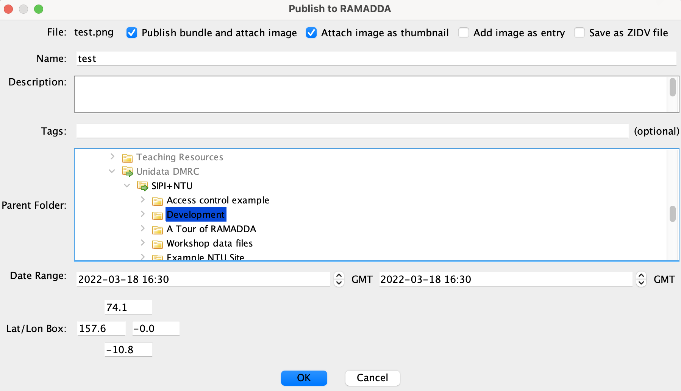
IDV/RAMADDA Integration
This lets you specify the new entry name, description, location, etc
After adding go back to RAMADDA and see the results
Select the destination entry in RAMADDA.
Projects->Unidata DMRC->SIPI+NTU
And press OK

